Slide 2
Locations
(Konumlar)

Slide 3
Ancient City
Village
Antik Kent
Köy
Castle
Beach/Seaside
Kale
Plaj/Deniz Kenarı

Slide 4
Mountain
Forest
Dağ
Orman
Lake
River
Göl
Akarsu/Nehir

Slide 5
Let's Play!

Slide 6
Holiday Activities
(Tatil Aktiviteleri)

Slide 7
Have a picnic
Walk in the forest
Piknik yapmak
Ormanda yürümek
Climb a tree
Pick flowers
Ağaca tırmanmak
Çiçek toplamak

Slide 8
Go village
Pick fruit
Köye gitmek
Meyve toplamak
Plant flowers
Milk a cow
Çiçek ekmek
İnek sağmak

Slide 9
Go camping
Stay in a tent
Kampa gitmek
Çadırda kalmak
Fish in the lake
Climb a mountain
Gölde balık tutmak
Dağa tırmanmak

Slide 10
Go sightseeing
Visit a fair
Şehir turuna çıkmak
Lunapark ziyaret etmek
See famous places
Visit museum
Ünlü yerleri görmek
Müze ziyaret etmek

Slide 11
Make a sandcastle
Play snowball
Kumdan kale yapmak
Kartopu oynamak
Pick up seashells
Make a snowman
Deniz kabuğu toplamak
Kardan adam yapmak
Go on a cruise tour
Try skiing
Gemi gezisine gitmek
Kayak denemek
Go sailing
Yelken sporu yapmak

Slide 12
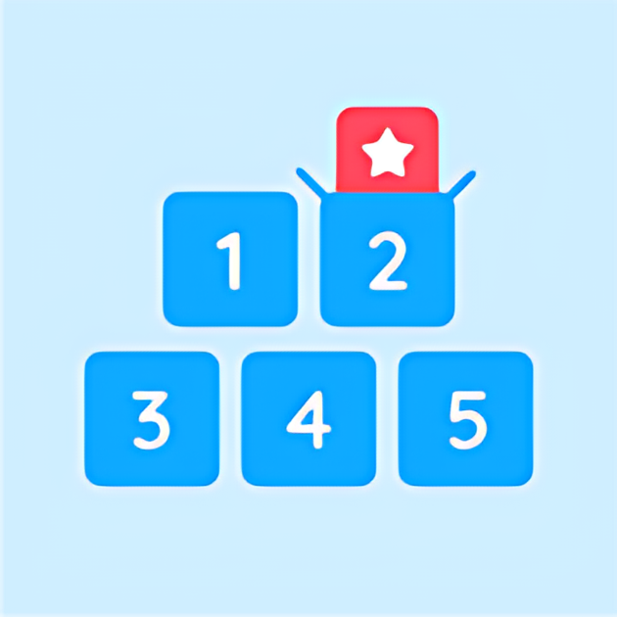
Let's Play!

Slide 13
Extra Words
(Ekstra Kelimeler)

Slide 14
Enjoy
Accommodation
Keyif almak
Konaklama
Join
Nature
Katılmak
Doğa
Incredible
Live
Fun
İnanılmaz
Yaşamak
Eğlenceli
Stay
Great
Konaklamak
Harika

Slide 15
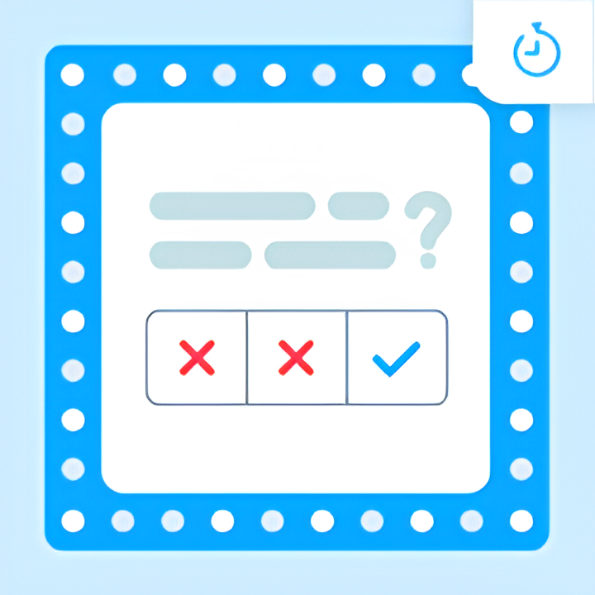
Let's Play!

Slide 16
The Simple Past Tense
(Geçmiş Zaman)

Slide 17
Where do we use it?
(Nerelerde Kullanırız?)
1. Actions that started and finished at a specific time in the past.
(Geçmişte belirli bir zamanda başlamış ve bitmiş eylemler.)
Ex: I went to school yesterday.
(Dün okula gittim.)
2. Several actions that were completed in the past.
(Geçmişte tamamlanmış birçok eylem)
Ex: I finished my homework, watched TV and slept.
(Ödevimi bitirdim,TV izledim ve uyudum.)
3. Past habits
(Geçmiş Alışkanlıklar)
Ex: I played football well when I was young.
(Gençken iyi futbol oynardım.)

Slide 18
How do we use it?
(Nasıl Kullanırız?)

Slide 19
(+) Affirmative Form
(Olumlu Cümle)
I
YOU
WE
THEY
HE
SHE
IT
Olumlu cümle kurarken tüm öznelerde fiil 2. Halinde kullanılır.
V2
(Fiil ikinci halini alır.)
Ex: I played football.
(Ben futbol oynadım.)
Ex: She went school.
(O okula gitti.)

Slide 20
Fiiler 2. haline dönüşürken «-ed» eki alır. Ancak bazı fiiller bu kurala uymaz ve dönüşüme uğrarlar. Bu fiillere düzensiz fiiller denir.
V2
Regular Verbs
Irregular Verbs
(Düzenli Fiiller)
(Düzensiz Fiiller)
Play
Played
Go
Went
Stay
Stayed
Do
Did

Slide 21
Regular Verbs
(Düzenli Fiiller)
Düzenli fiiller genellikle «-ed» ekini alır.
start
started
visit
visited
Not: Fiilin son harfi «-e» ise fiil sadece «-d» ekini alır.
graduate
graduated
prepare
prepared
Not: Fiil «-y» harfiyle bitiyorsa ve «-y» den önceki harf sessiz ise «-y» harfi düşer ve fiil «-ied» ekini alır,
study
studied
try
tried
«-y» harfi bir sesli harften sonra gelir ise fiil «-ed» ekini alır.
play
played
stay
stayed

Slide 22
Irregular Verbs
(Düzensiz Fiiller)
V1
V2
V1
V2
Be (Olmak)
Was / Were
Choose (Seçmek)
Chose
Become (Olmak)
Became
Come (Gelmek)
Came
Begin (Başlamak)
Began
Cut (Kesmek)
Cut
Break (Kırmak/Bozulmak)
Broke
Do (Yapmak)
Did
Bring (Getirmek)
Brought
Draw (Çizmek)
Drew
Build (İnşa etmek)
Built
Drive (Sürmek)
Drove
Buy (Satın almak)
Bought
Eat (Yemek)
Ate
Catch (Yakalamak)
Caught
Fall (Düşmek)
Fell

Slide 23
Feel (Hissetmek)
Felt
Hear (Duymak)
Heard
Find (Bulmak)
Found
Hit (Vurmak)
Hit
Fly (Uçmak)
Flew
Keep (Tutmak)
Kept
Forget (Unutmak)
Forgot
Know (Bilmek)
Knew
Get (Almak)
Got
Lead (Liderlik etmek)
Led
Give (Vermek)
Gave
Leave (Ayrılmak)
Left
Go (Gitmek)
Went
Lose (Kaybetmek)
Lost
Grow (Büyümek)
Grew
Make (Yapmak)
Made
Have (Sahip olmak)
Had
Meet (Tanışmak/ Buluşmak)
Met

Slide 24
Pay (Ödemek)
Paid
Sing (Şarkı söylemek)
Sang
Put (Koymak)
Put
Sit (Oturmak)
Sat
Read (Okumak)
Read
Sleep (Uyumak)
Slept
Ride (Sürmek)
Rode
Speak (Konuşmak)
Spoke
Run (Koşmak)
Ran
Spend (Harcamak)
Spent
Say (Söylemek)
Said
Swim (Yüzmek)
Swam
See (Görmek)
Saw
Take (Almak)
Took
Sell (Satmak)
Sold
Teach (Öğretmek)
Taught
Send (Göndermek)
Sent
Tell (Söylemek)
Told

Slide 25
Think (Düşünmek)
Thought
Understand (Anlamak)
Understood
Wake (Uyanmak)
Woke
Win (Kazanmak)
Won
Write (Yazmak)
Wrote
Wear (Giyinmek)
Wore

Slide 26
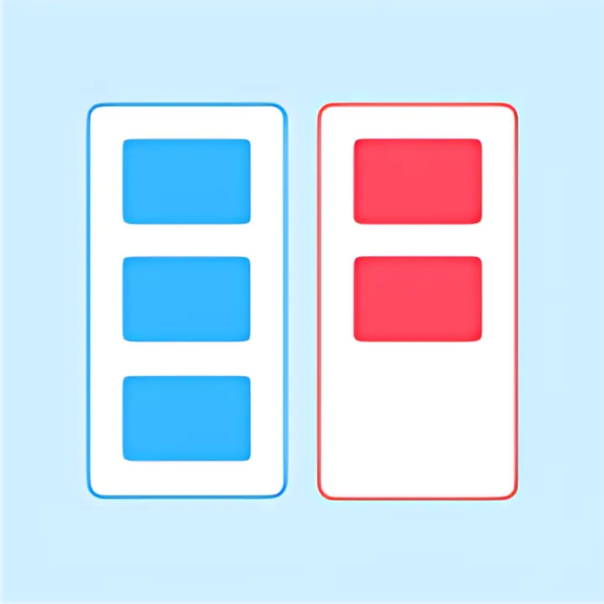
Let's Play!

Slide 27
Let's Play!

Slide 28
Be fiilinin 2. hali «Was/Were» olarak ikiye ayrılır;
Be
Was
Were
I / He / She / It
You / We / They
Ex: She was born in Ankara.
Ex: They were born in Ankara.

Slide 29
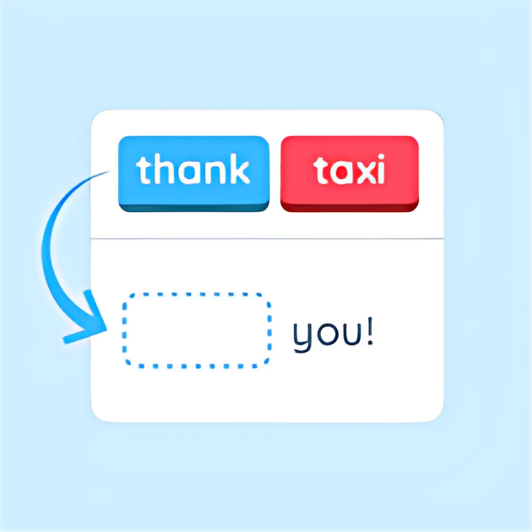
Let's Play!

Slide 30
Exercises
1) Susan _______ (get) her diploma last summer.
got
received
2) Einstein _______(receive) an award for his studies.
achieved
3) Canan Dağdeviren _______ (achieve) lots of success in science.
were
4) Elisa and Daisy _______ (be) born in 2005.
moved
5) My parents _______ (move) to New York.
6) John and Lina _______ (get) married five years ago.
got
7) My aunt _______ (raise) five children.
raised

Slide 31
(-) Negative Form
(Olumsuz Cümle)
I
YOU
WE
THEY
HE
SHE
IT
Olumsuz cümle kurarken tüm öznelerde «didn’t» + fiilin yalın hali kullanılır.
didn’t + V1
Ex: I didn’t play football.
(Ben futbol oynamadım.)
Ex: She didn’t watch TV.
(O TV izlemedi.)

Slide 32
Exercises
didn’t grow
1) Marie Curie __________ (not/grow) up in Germany.
didn’t learn
2) She __________ (not/learn) many languages.
didn’t invent
3) The Wright Brothers __________ (not/invent) the TV.
didn’t invent
4) They __________ (not/get) engaged last summer.
didn’t have
5) Patrick __________ (not/have) a big house.
6) My uncle __________ (not/die) in 2022. He died last year.
didn’t die
7) Shakespeare __________ (not/write) fifty-five plays.
didn’t write

Slide 33
(?) Question Form
(Soru Cümlesi)
Soru cümlesi kurarken tüm öznelerden önce «Did» yardımcı fiili kullanılır.
Özneden sonra ise fiil yalın halde kullanılır.
I
YOU
WE
THEY
HE
SHE
IT
V1
?
Did
Ex: Did you play football ?
(Sen futbol oynadın mı ?)
Ex: Did she watch TV ?
(O TV izledi mi ?)

Slide 34
Exercises
Did Aziz Sancar win
1) _______________ (Aziz Sancar/win) the Nobel Prize?
Did they have
2) _______________ (They/have) children?
Was Elvis Presley
3) _______________ (Elvis Presley/be) famous for rock and roll ?
Did Nihal Başar work
4) _______________ (Nihal Başar/work) on the education?
Did Steve Jobs found
5) _______________ (Steve Jobs/found) his company in 1976?
Did your father get
6) _______________ (Your Father/get) retired?
Did Colombus discover
7) _______________ (Colombus/discover) America?

Slide 35
The Simple Past Tense (Geçmiş Zaman)
I
YOU
WE
THEY
HE
SHE
IT
I
YOU
WE
THEY
HE
SHE
IT
V2
(Fiil ikinci halinde kullanılır.)
Did
V1
?
didn’t + V1
Ex: I went to school.
Ex: I didn’t go to school.
Ex: Did you go to school?

Slide 36
Time Expressions
(Zaman İfadeleri)
Yesterday
(Dün)
Ago
Ex: Jack was at home yesterday.
(Önce)
(Jack dün evdeydi.)
Five minutes ago
(Beş dakika önce)
Two days ago
(İki gün önce)
Ex: They were in Paris two years ago.
Ten years ago
(On yıl önce)
(Onlar iki yıl önce Paris’teydi.)
Last
(Geçen)
Ex: Lina graduated from University last year.
Last Friday
(Geçen cuma)
(Lina geçen sene üniversiteden mezun oldu.)
Last month
(Geçen ay)
Last year
(Geçen sene)

Slide 37
Let's Play!

